Slide 1
Study Source
Alice, Mark, Florent, Daniel

Slide 2
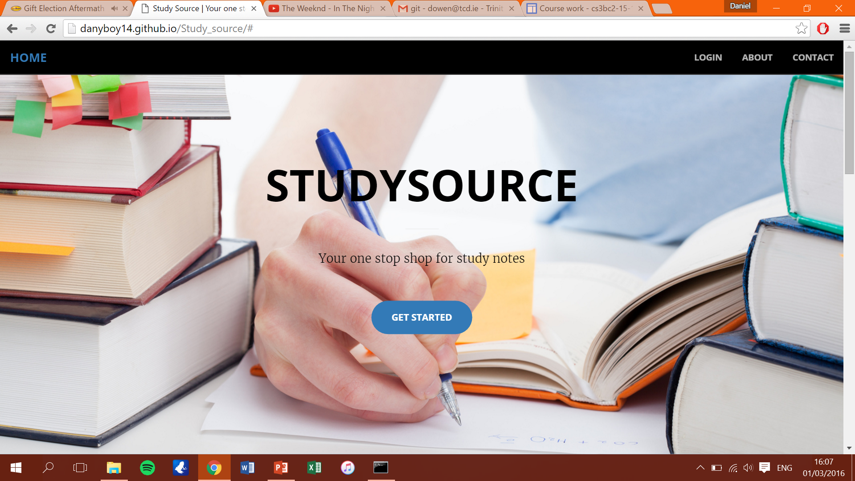
Website address: danyboy14.github.io/Study_source
This is our website hosted on Github which is in its present state online.

Slide 3
We currently have a few very good looking features on our website, the first of which is the home page.
Our website fully supports new users who are looking to sign up to the service.

